Slide 1
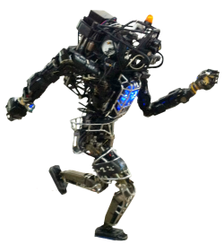
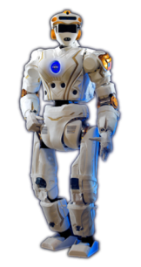

Simulation Software:
A User’s Experience
Jerry Pratt
December 13, 2016
Simpar
2016 Simulation Grand Challenges Workshop
Institute for Human and Machine Cognition
Pensacola, Florida

Slide 2

Pensacola, FL

Slide 3
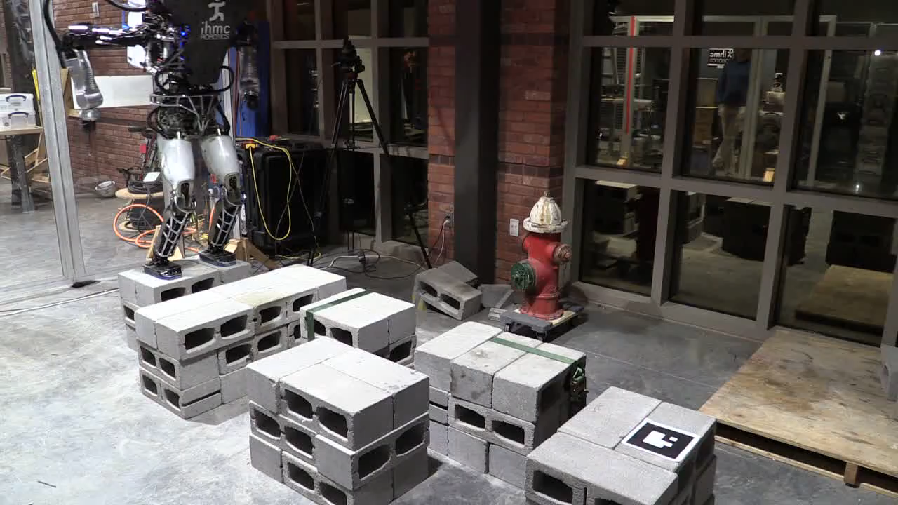
Typical Robot Run

Slide 4
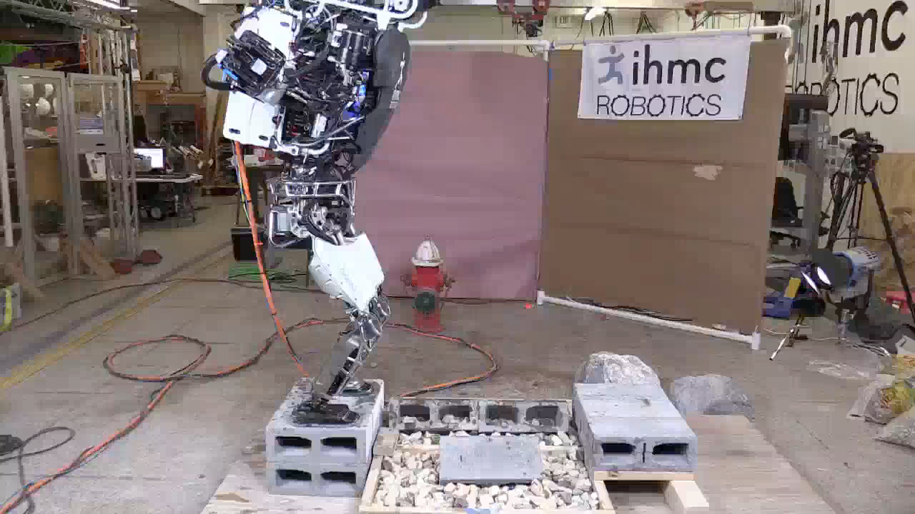
Typical Robot Run

Slide 5
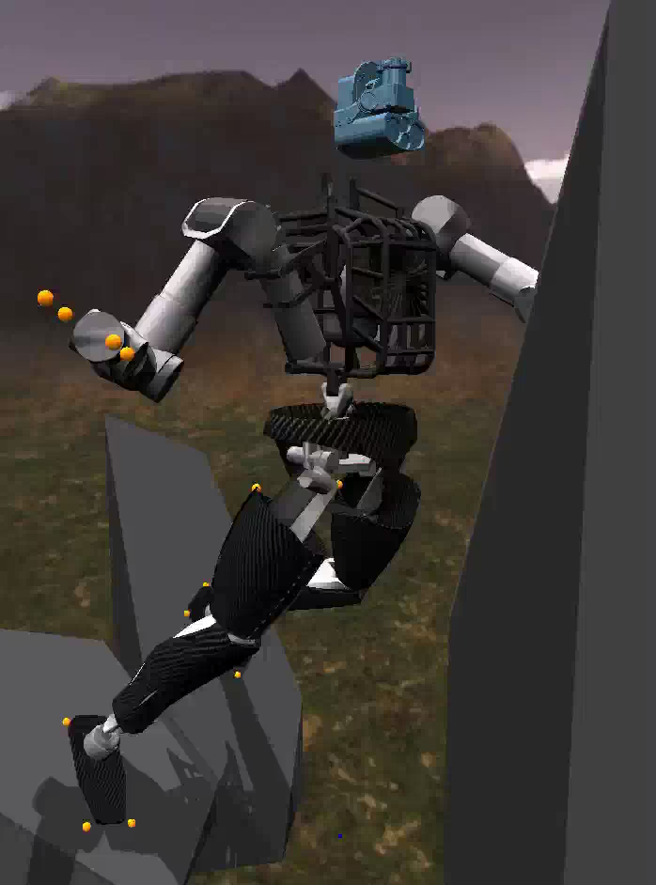
Typical Simulation Run

Slide 6
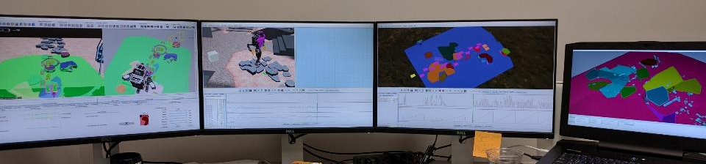
Typical Simulation
Perception
Visualizer
Simulation
Operator Interface
Planner
Visualizer

Slide 7
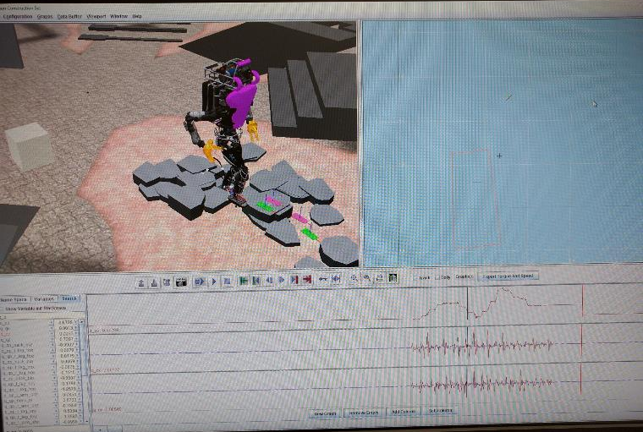
Typical Simulation
3D Viewport
Overhead Plotter
Variable Entry Boxes
Variable Plots

Slide 8
IHMC Simulation Uses
Roboticists for Virtual Testing.
Roboticists for Virtual Prototyping.
Simulation Researchers Algorithm Implementers.
Roboticists for Machine Learning.
We try to get everything working well in Simulation before running on the real robot.
Usually require some parameter tweaks and tuning on the robot itself.

Slide 9
Simulation Construction Set
20 to 200 Year Old Technology!
Rigid Body Dynamics: Featherstone Algorithm.
Contact Detection: Point to Surface.
Contact Response: Spring/Dampers with non-linear stiffening z (up) spring.
Stick Slip Friction: Remember touchdown points and slip them when outside of friction cone.
Runge-Kutta 4 or Simple Euler Integrator.
Typically 0.1 msec fixed step time.
Import models:
Programmatically
URDF/SDF

Slide 10
Simulation Construction Set
Usability is Priority #1 for us!
Runs on Windows, Mac, Linux
Apache 2.0 License
Java
3D World Graphics with Texture Mapping
Record everything. (10,000 variables + typically)
Variable Plots
Easy Visualization
Rewindable
Can programmatically interact with UI.
Easy integration in unit tests.
Plays nicely with other processes.

Slide 11
Simulation Construction Set
Same interaction whether running sim or real robot.
Actuator models: Torque limits, bandwidth, friction.
Sensor models: Camera, Lidar, Joint force/torque, contact sensing.
For complex humanoid approx. 1/2 to 1/6 real time rate depending on whether or not hands and manipulation.
Simulation behaves very similar to real robot in a lot of ways, though things tend to work better in sim due to lack of modeling of stiction, backlash, sensor drift, crappy hardware.

Slide 12
Features Currently Adding
Manipulation is Becoming More Important for us!
Better manipulation support.
GJK / EPA Collision Detection.
Combined impulse / spring-damper collision response.
Parallel Processing of collisions.

Slide 13
Grand Challenge: Not Cheat in Simulation
Add time delays.
Add sensor noise.
High frequency noise.
Low frequency bias drift.
Add actuator limitations.
Bandwidth
Force/torque curve
Actuator noise, hysteresis, bias drift.
Add stiction, backlash, link compliance.
Walk on unknown, rough ground.

Slide 14
Grand Challenge: Integration
Simulation
Robot Controller
State Estimator
Sensors.
Sensor Processing.
Perception.
High Level Planning.
User Interface and Interaction.
….
Moore is in retirement. All of these have to run on a separate process to be fast. Comms and Spinup is a challenge.

Slide 15
Grand Challenge: Easily integrate simulation and real robot
Each time we get a new robot:
1 week to import model, starting with SolidWorks CAD
3 months to incorporate low level sensor reading, processing, etc.
Goal:
1 hour to create and import a model.
1 week to incorporate sensor reading, processing, etc.

Slide 16
Grand Challenge: Simulation Validation
Switch between simulation engines seamlessly.
Understand how well simulation is modeling real robot.
Model the robots better, especially noise, stiction, sensor drift, etc.

Slide 17
Other Thoughts
Run multiple sims in parallel with same controller but different robot parameters to ensure the robustness of a controller to model variation.

Slide 18
Simulation Software:
A User’s Experience
Jerry Pratt
December 13, 2016
Simpar
2016 Simulation Grand Challenges Workshop
Institute for Human and Machine Cognition
Pensacola, Florida

